Slide 1

Intro To Java & Computer Science
STEM For Others ©

Slide 2
Table of Contents
Intro + Activity
Data Types + Project
Conditionals
String Methods
Strings and Object Referencing
Review of Week 1-5 + Challenge
Classes + Objects 1
Classes + Objects 2
9. Classes + Objects 3
10. Data Structures
11. Data Structures 2
12. Semester Project
13. Semester Project
14. Semester Project
15. Semester Project
Additional Project Resources: Java Project List

Slide 3
Week 1 - What is Java?
Programming Language - You tell the computer what you want it to do.
The “languages” of computer programs: a set of commands that tells the computer what to do
What you see on the screens of your computers are all from computer programs
Notes:
To put it simply, when coding, your are telling the computer what to do

Slide 4
Why is it useful to learn?
Learning Java allows you to create your own programs
Technology is becoming more and more important in our daily lives
You can program games; Minecraft is programmed in Java

Slide 5



Why Java?
Simple to learn
High skill ceiling
It is a very commonly used language
Spotify, Minecraft, Netflix
Notes:
Easy for you guys to learn

Slide 6
Lets try it out!!
Go to your computer’s browser and open repl.it (Set-up accounts if necessary)
Open a Java file
Try to get it to print out the words “Hello World!”
Notes:
Easy for you guys to learn

Slide 7
Lets try it out!!
Go to your computer’s browser and open repl.it
Open a java file
Try to get it to print out the words “Hello World!”
Hint: System.out.print(“what you want to say”)
Notes:
Easy for you guys to learn

Slide 8
System.out.println()
System.out.println() makes a new line after printing the statement
System.out.print() does not make a new line after printing the statement
Try it!
Notes:
Easy for you guys to learn

Slide 9
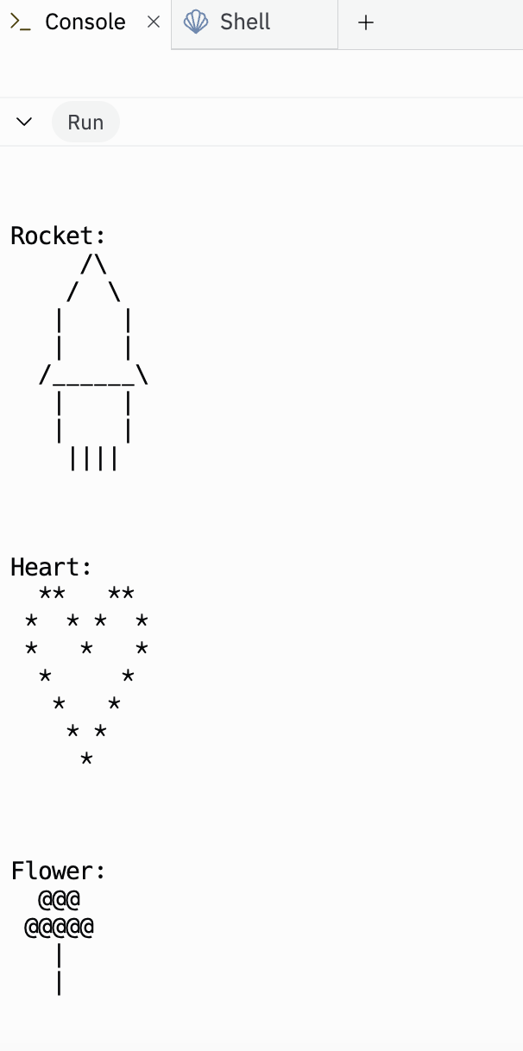
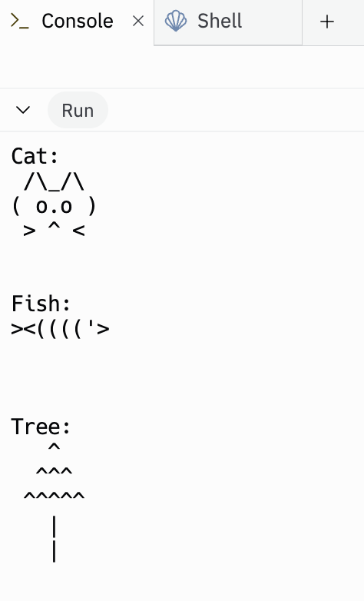
Project
Try making cool shapes and drawings by using System.out.println() for many lines!
For example, try making these cool shapes and drawings!!

Slide 10
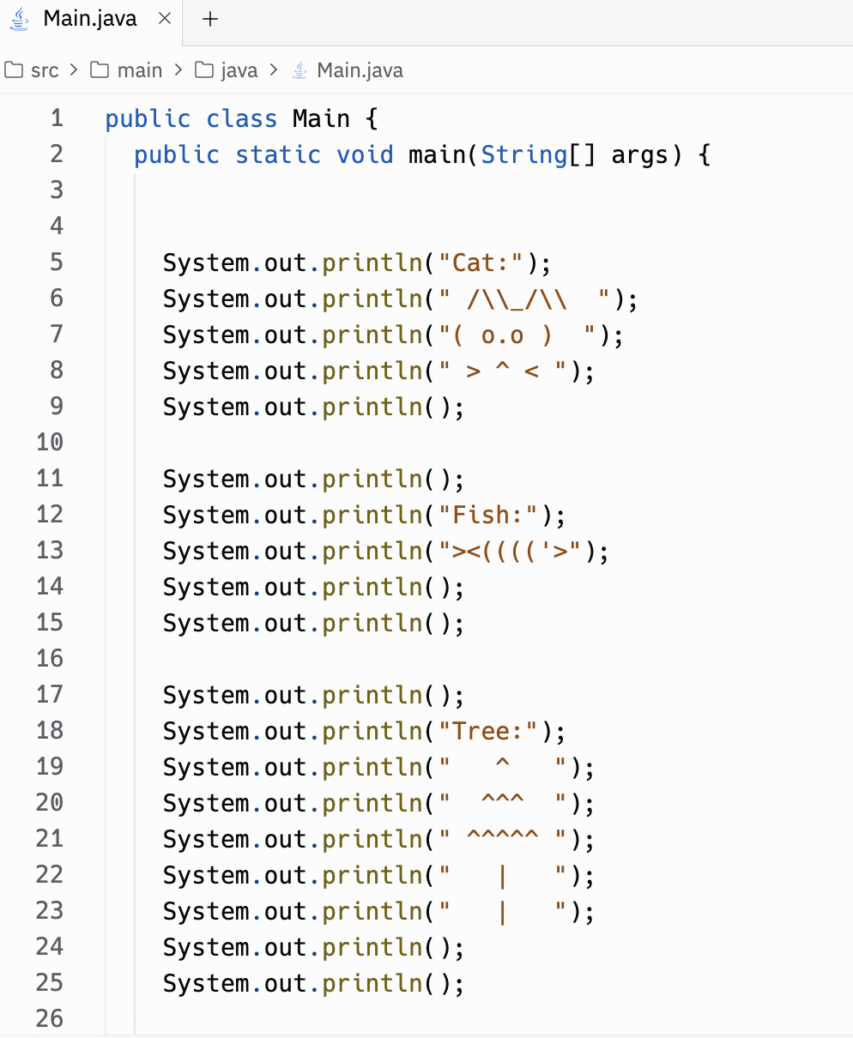
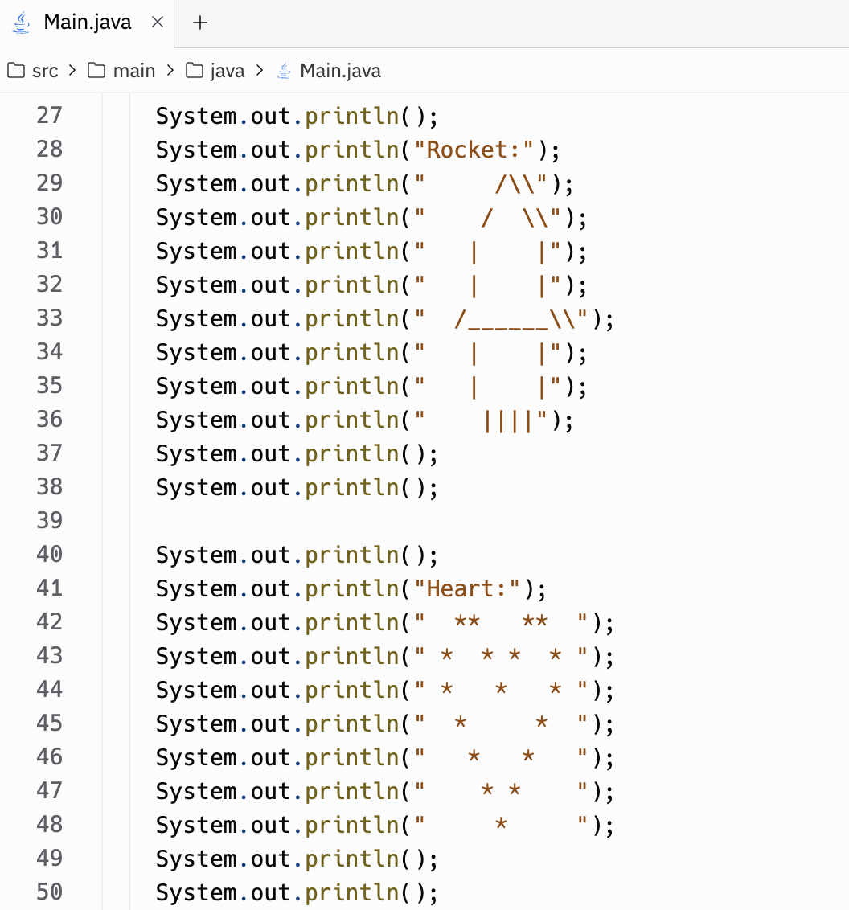
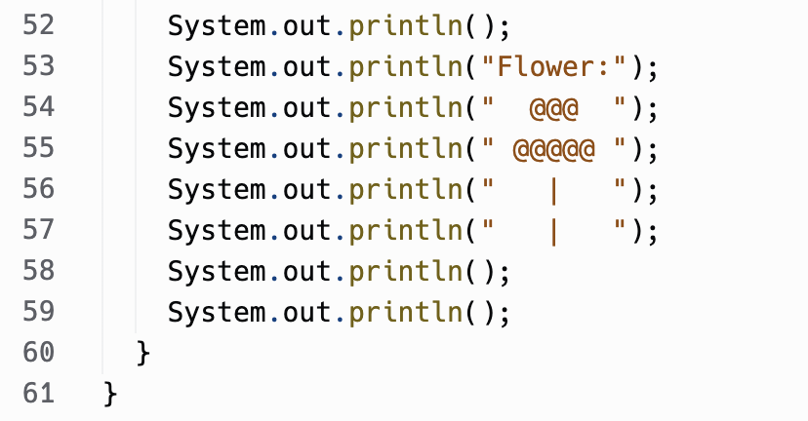
Project Solution
Solution code for the drawings!

Slide 11
Week 2 - Primitive Data Types, Variables
Data Types: Different attributes used to define data.
Primitive Data Types: The most simple data types, cannot be simplified further.

Slide 12
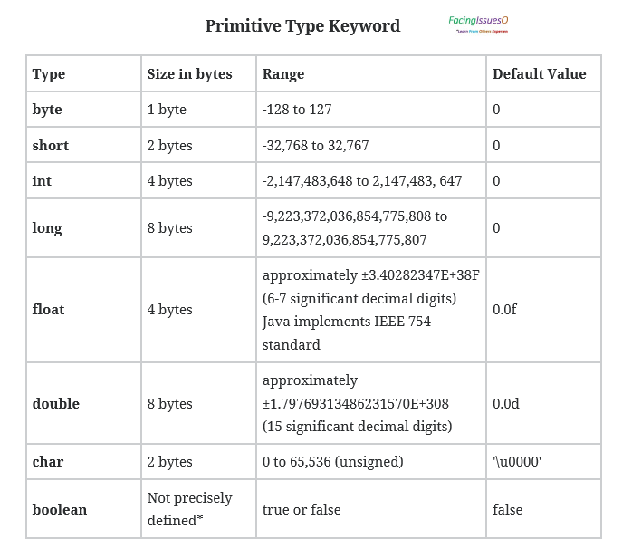
Data Types, Variables, + Input Function
Data Types: Different attributes used to define data.
Integer (int): Whole numbers. Positive or negative without decimals
Boolean (boolean): True or False binary
Double (double): decimal numbers
Character (char): Just one letter

Slide 13
Why do we have different classifications of data?
There are several reasons. One of the main reasons is to help with comparing two things.
Can only compare these
if they are the same data type
(like dividing “c” by 7.2, it
doesn’t make sense)

Slide 14
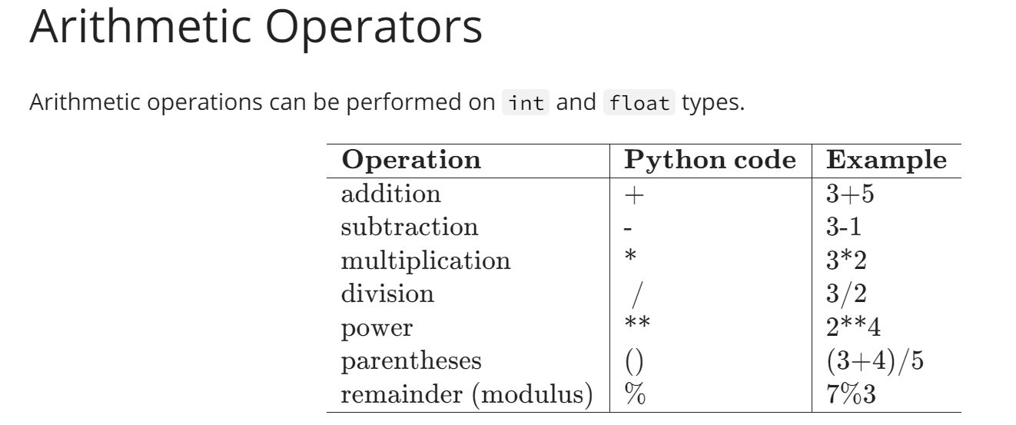
Why do we have different classifications of data?
There are several reasons. One of the main reasons is to help with comparing two things.
Can only compare these
if they are the same data type
(like adding “k” by 8, it
doesn’t make sense)
Practice:
Print out the product of 3 and 10
Print out the sum of 3.5 and 2.0
Bonus: print out the sum of ‘c’ and 29

Slide 15
Variables
We’ve been practicing data types in a print function. But what if we want to store and reuse some values that we got or used from our print function for other purposes?

Slide 16

Variables
We’ve been practicing data types in a print function. But what if we want to store and reuse some values that we got or used from our print function for other purposes?
That’s why variables help! Variables are basically
like boxes where you can put your toys in to save
for later

Slide 17

Variables pt.2
We can give names to these boxes and whenever we want to reuse that data in the box, we can simply call the box name and it will give us the value.

Slide 18
Variables pt.2
We can give names to these boxes and whenever we want to reuse that data in the box, we can simply call the box name and it will give us the value.
The name of the variable is key sensitive. No spaces, if you use different capitalization, you have to call the variable using the exact same capitalization
Even if two variables have the same value, they can be different data types and you cannot compare these two which can mess up what you want to achieve.

Slide 19
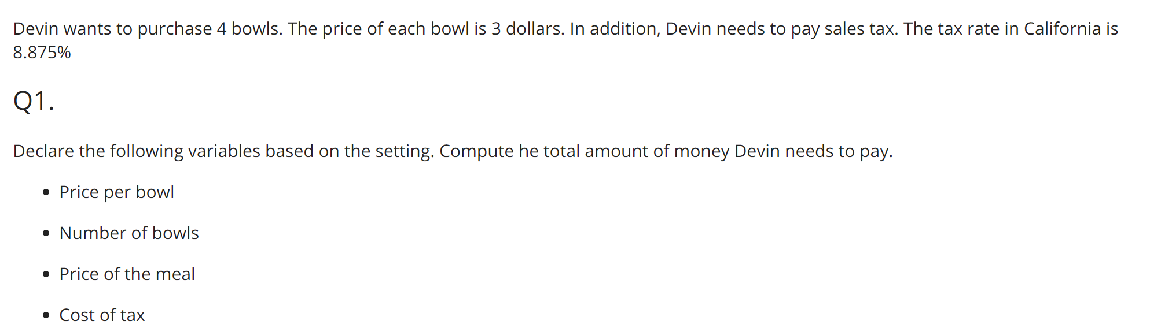
Practice:

Slide 20


Week 2 Project - Writing a Letter
For this weeks project, we are going to write a letter to any person in the world using what we have learned so far.
To start, search up https://www.bluej.org/ on your web browser and scroll down to the section titled “Download and Install” and click on Windows/macOS (based on what laptop you have)
Finish the setup, open up BlueJ, and click on Project > New Project and rename the project to “writingaletter”
In case you were wondering, Blue J is a free development environment that allows you to develop Java programs quickly and easily!

Slide 21
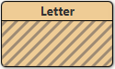
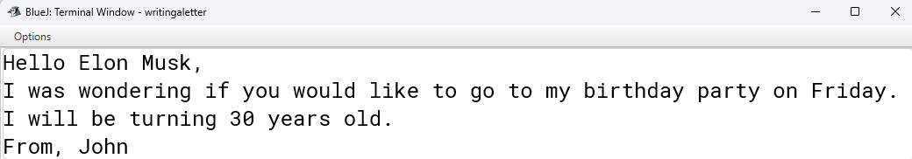
Week 2 Project - Writing a Letter
Click on New Class > change class name to “Letter” and click OK > click on to open the class.
*Delete all of the code written in the program currently, you won’t need it for this project.*
Objective
Combine strings and variables to generate a simple letter like this!
In order to combine string and variables, we need to understand what string concatenation is!

Slide 22
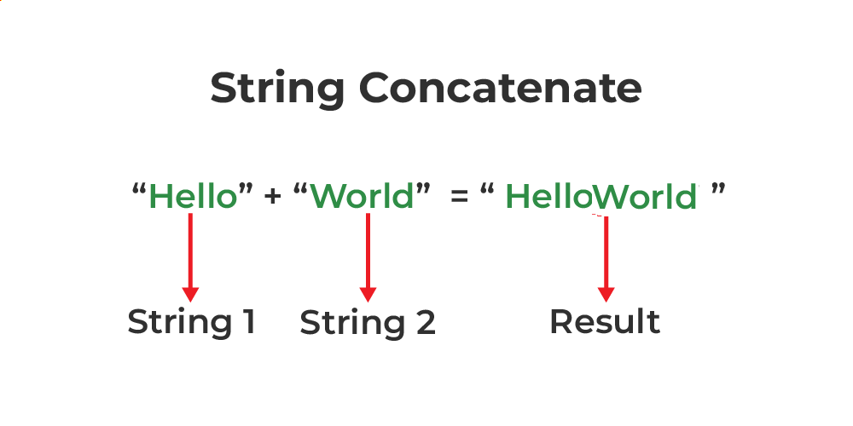
String Concatenation
concatenation (Merriam-Webster definition): a group of things linked together or occurring together in a way that produces a particular result or effect
String Concatenation - joining two or more strings to create a single new string
Now that we know string concatenation, let’s practice it!

Slide 23
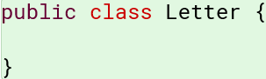
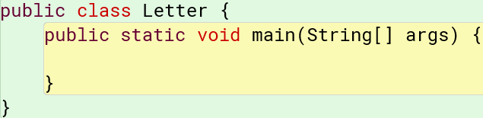
String Concatenation
In BlueJ, let’s write a line of code involving string concatenation. First we need to write our class header. Write this line of code.
Then write Java’s main method inside your class header, like this:
Java’s main method will be explained in the next slide.

Slide 24
Java’s main method
Main method: public static void main (String[] args)
It is the entry point for any Java program.
Keywords
public - makes the method accessible from anywhere
static - allows the method to be called without creating an instance of the class
void - indicates that the method doesn’t return any value
String[] args - array that stores command-line arguments, allowing users to input data when they run the program
This setup is essential for Java programs to function correctly.

Slide 25
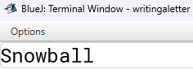
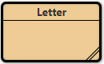
String Concatenation
Let’s make the word Snowball. Write this string variable inside our main method in BlueJ.
On the next line, write this line of code to print out Snowb
all to our output window.
Click on Compile (and debug if needed) > right click
> click on “void main(String[] args)” and click OK to see your result ->

Slide 26
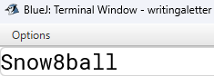
Concatenation with a Variable
Let’s concatenate (connect) the strings we used to make the word “Snowball” with a variable to create the word “Snow8ball”.
Write this line of code on the line above the string variable 8.
Then, plug in variable num in your string variable word like this:
Click on Compile (and debug if needed) > right click
> click on “void main(String[] args)” and click OK to see your result ->

Slide 27
Writing the Letter
Now that we know how to concatenate strings and variables, we can write our letter!
Tasks
Your letter should include a greeting (Hello, Jane) and a closing (From, John).
It should talk about an event, include a number, and another person’s name.
You need four different variables, one variable that includes all of the other three variables.
Use string and variable concatenation.
Print out your letter to the terminal window using System.out.println().

Slide 28
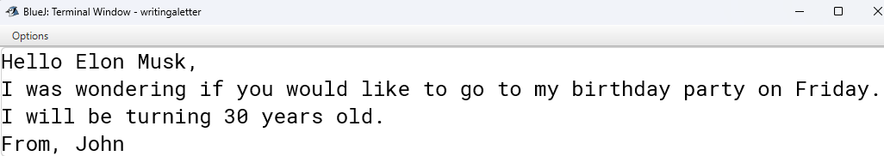
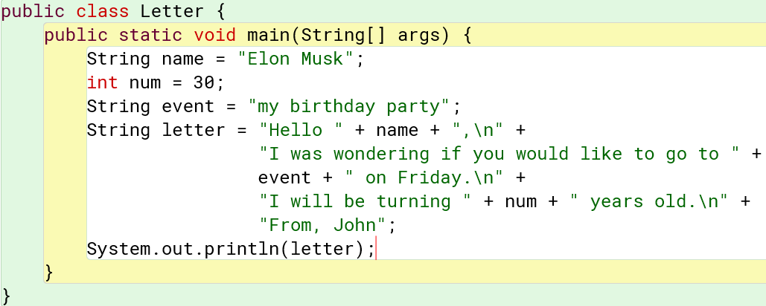
Week 2 Project Solution
Output:
Code Solution:

Slide 29
Week 3: Conditionals & Loops
Review: Variables and Datatypes
Name the datatype

Slide 30
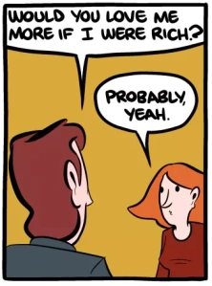
Week 3: Conditionals
Conditionals are statements that require a condition to be true for the statement to be executed.
Ex: If we are hungry, we go to the fridge. If we are not hungry, we will continue doing HW.
In code, there are 3 main conditionals: If statements, While loops, and For loops
Each has its own specific syntax and if you don’t write it out properly, it will give errors

Slide 31
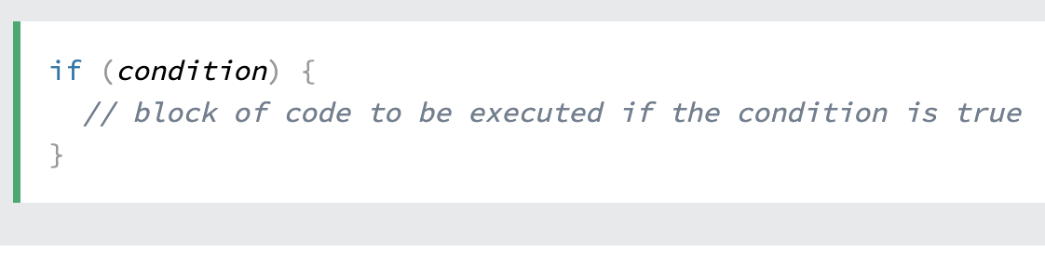
Week 3: Conditionals & Loops
Parts of the conditional
if
condition
Curly bracket
indentation
end result

Slide 32
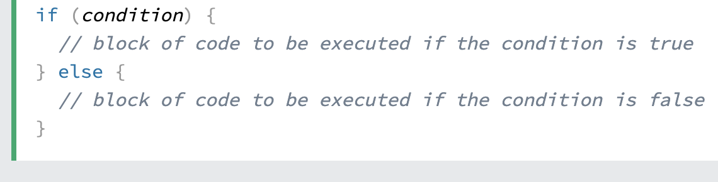
Week 3: Conditionals & Loops
Parts of the conditional
if
condition
curly brackets
end result
Otherwise the condition executes the other end result.
If the condition is true, we can execute the end result

Slide 33
Week 3: Conditionals & Loops
Parts of the conditional
if
condition
curly brackets
end result
Otherwise the condition executes the other end result.
If the condition is true, we can execute the end result

Slide 34
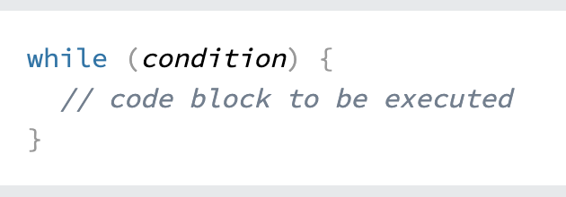

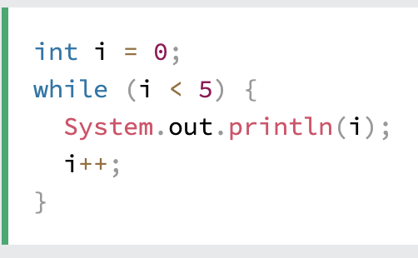
Week 3: Conditionals & Loops
Similar to if statement, but while loops will go on forever until the condition isn’t satisfied
(Try it yourself!)
Each time we go through the loop, we add 1 to i until it is equal to 5.

Slide 35
Week 3: Conditionals & Loops
Practice: Can we write a while loop to add 1 to i until it equals 27?
Similar to if statement, but while loops will go on forever until the condition isn’t satisfied
(Try it yourself!)
Each time we go through the loop, we add 1 to i until it is equal to 5. When it is equal to 5, we don’t go through the loop.

Slide 36
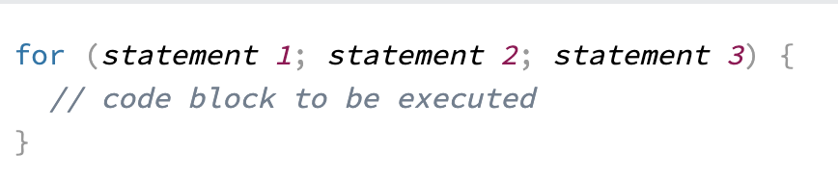
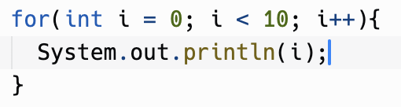
Week 3: Conditionals & Loops
Similar to while loops, for loops go on until the 2nd statement is fufilled
Each time we go through the loop, we add 1 to i until it starts to equal 10.

Slide 37
Week 3: Conditionals & Loops
The first statement is executed once before everything else
The second statement is the condition that the loop needs to reach before it ends
The third statement is what happens to the variable in the first statement after every loop
Similar to while loops, for loops go on until the 2nd statement is fulfilled
Each time we go through the loop, we add 1 to i until it starts to equal 10.

Slide 38
Week 3: Conditionals & Loops
The first statement is executed once before everything else
The second statement is the condition that the loop needs to reach before it ends
The third statement is what happens to the variable in the first statement after every loop
Similar to while loops, for loops go on until the 2nd statement is fulfilled
Practice: Just like the while loop, can we write a for loop to add 1 to i until it equals 27?

Slide 39
Week 3: Project!!
Objective: Your task is to create a Java game where the player has to guess a randomly generated number between 1 and 100. The player will have 10 attempts to guess the correct number. After each guess, the game will tell the player whether their guess was too high, too low, or correct. If the player runs out of attempts without guessing correctly, the game will end.
Game Setup:
The program should generate a random target number between 1 and 100.
The player will have 10 attempts to guess the target number.
The program should give feedback after each guess: whether the guess is too high, too low, or correct.
The game should end when the player guesses correctly or runs out of attempts.
Looping and Conditionals:
Use a while loop to keep track of the player's guesses and remaining attempts.
Use if-else statements to check whether the guess is too high, too low, or correct.
After each guess, display how many attempts are left, unless the game is over.
End Game:
If the player guesses the correct number, print a congratulatory message.
If the player runs out of attempts without guessing correctly, print a game over message, revealing the correct number.
User Interaction:
The player should be prompted to enter their guess after each round.
The program should continuously update the player on how many attempts they have left.

Slide 40
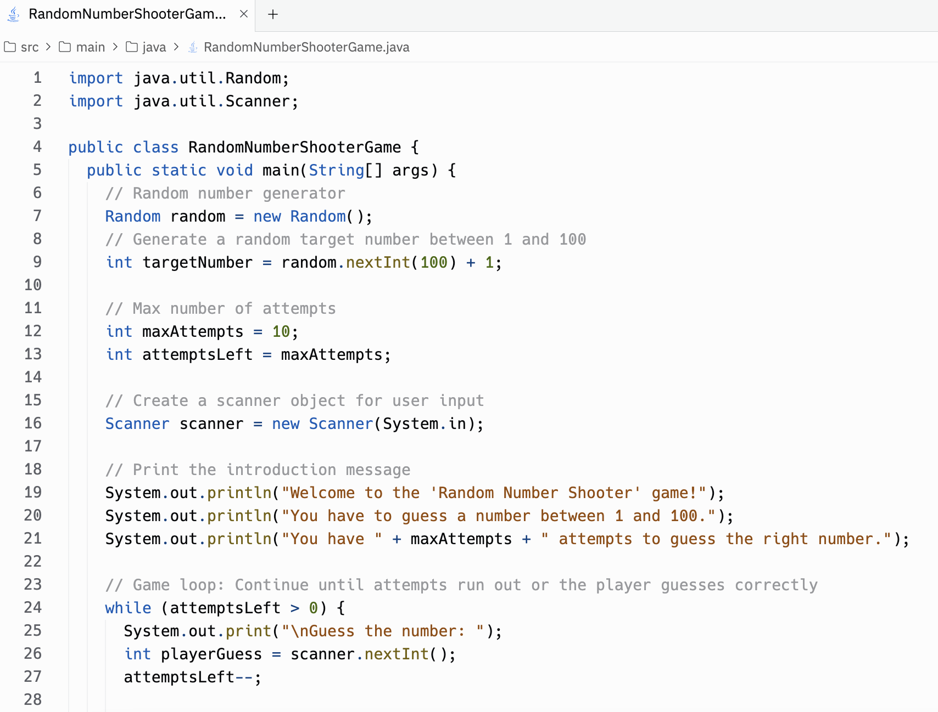
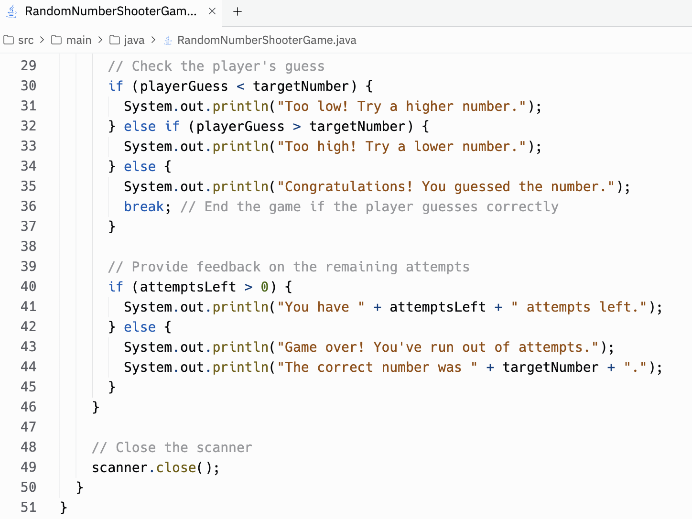
Week 3: Project Solution

Slide 41
Week 4: String Methods
The Java String class has a variety of built in methods that you can use on strings. They are very useful and helpful to know. Some of the most important string methods are:
int length() - returns the number of characters in a string object
String substring(int from, into to) - returns the substring beginning at index from and ending at index - 1
int indexOf(String str) - returns the index of the first occurrence of str; returns -1 if not found
boolean equals(String other) - returns true if string this equals string other; returns false otherwise

Slide 42
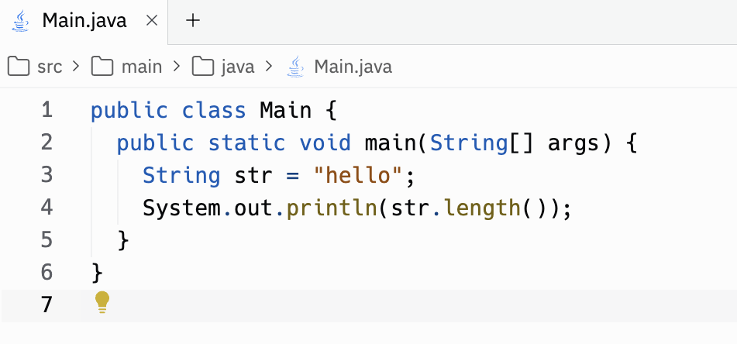
Week 4: String Methods
String methods are called on string objects using the dot notation
Format: string name + period + function name + parenthesis
<- Prints out 5, the number of characters in the string “hello”.

Slide 43
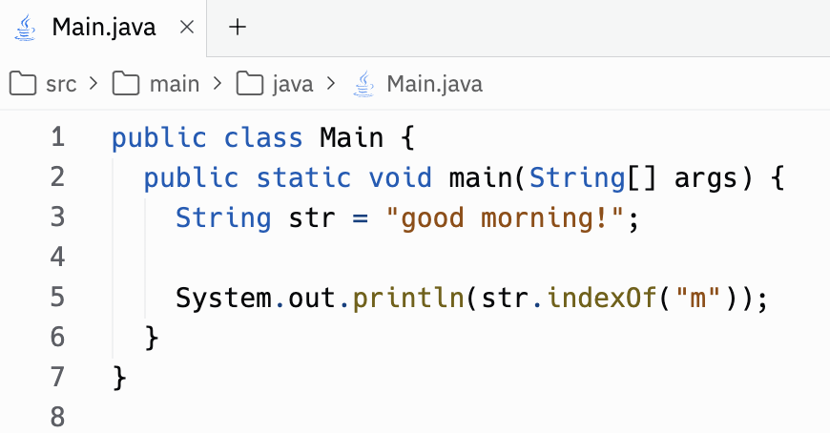
Week 4: String Methods
Try it out!!
Open a new java file in repl.it
Create a new string
Try out the different string methods and print them out!
Practice: what will this code print out? (remember, indexes start at 0)

Slide 44
Week 5: String and Object Referencing
Objects, or variables of non-primitive types, hold references (or pointers) to the actual data stored in memory.
When you create an object, you create a reference variable that points to that object which allows you to access the value of that object.
For example:
Here, person is a reference variable pointing to an instance of the Person class.

Slide 45
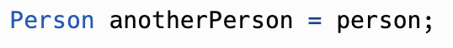
Week 5: String and Object Referencing
When you assign one reference variable to another, both references point to the same object
For example:
Now, both person and anotherPerson reference the same Person object.
That means that if you make any changes to person, when you access anotherPerson, the same changes will have been made to anotherPerson, and vice versa.

Slide 46
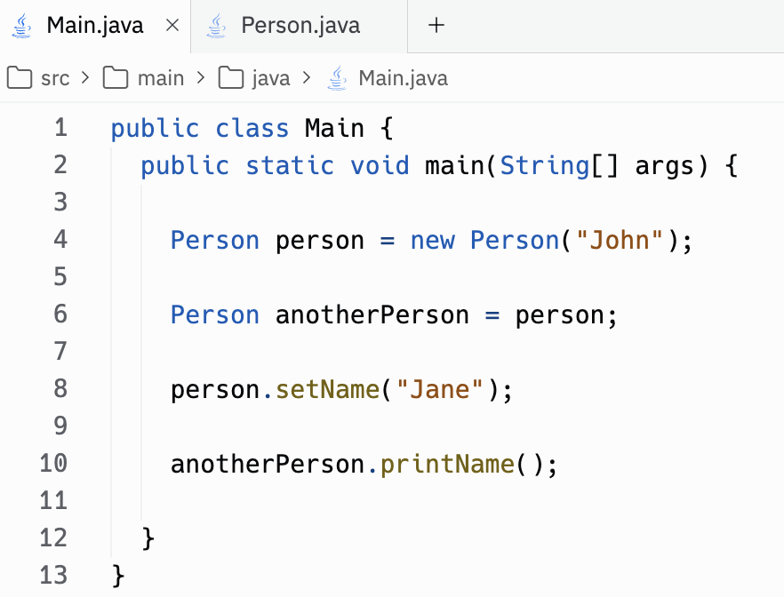
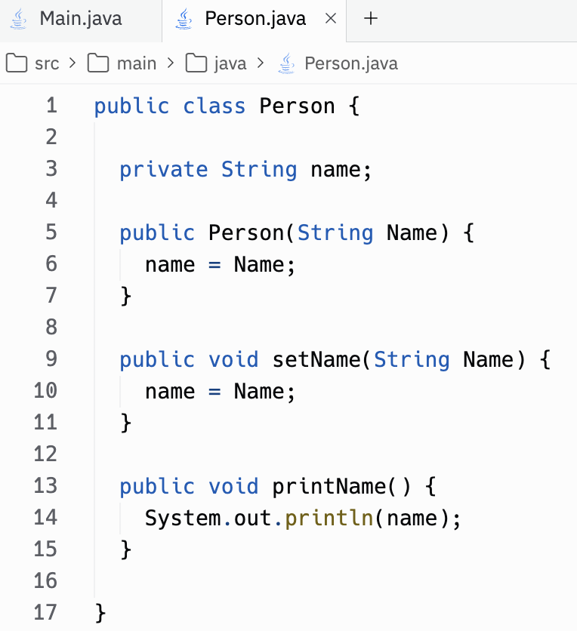
Week 5: String and Object Referencing
Practice: What is printed out?
For reference: this is the Person class

Slide 47

Week 5: String and Object Referencing
Strings are immutable, which means that once a String object is created, its value cannot be changed.
Methods that appear to modify a string actually create a new string object
Strings can be created in two ways:
1: String Literal
When you use string literals, Java has a pool of strings and checks if the string exists in the pool. If it does, the existing reference is returned, or else a new string is added to the pool.

Slide 48
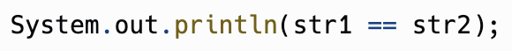
Week 5: String and Object Referencing
2: Using the new keyword
This explicitly creates a new string object in memory, even if an equal string exists in the string pool.
str1 and str2 reference different memory locations, even they have the same contents, because str2 was explicitly created with the new keyword which creates a new string object in memory, different from the one of str1
Practice: What does this print?

Slide 49
Week 6: Review of Week 1-5 + Challenge
Data types are different attributes used to define data
Data types are split into two groups: primitive and non-primitive data types
If statements allow you to make decisions based on certain conditions
For loops are used to iterate over code based on a condition when you know how many times it will repeat
While loops are used to iterate over code when you don’t know how many times it will repeat
The Java String class has many useful built-in methods that you can use on strings with dot notation
Objects, which are variables of non-primitive types, hold references to the actual data stored in memory
String objects are immutable, which means that once a string object is created its value cannot be changed
Strings can be created either using string literals or using the new keyword

Slide 50
Week 6: Review of Week 1-5 + Challenge
Challenge: Create your own Wordle!
Rules: Player gets 6 tries to guess the 5-letter word which you choose. For the word the player guesses to count as a guess, the word needs to be 5 letters long.
Hints: (not required, just some ideas and pointers if you get stuck!)
import and use the Scanner class to read in user input
use break to break out of a loop
use a for loop with if and else if statements in it, and an else statement at the end of the loop to catch everything else
Have an if statement after the loop for when the right word is never guessed
Use a boolean to keep track of whether or not the word is guessed
*For an extra challenge, keep track and print out how many guesses the player has left every time they guess a word!

Slide 51
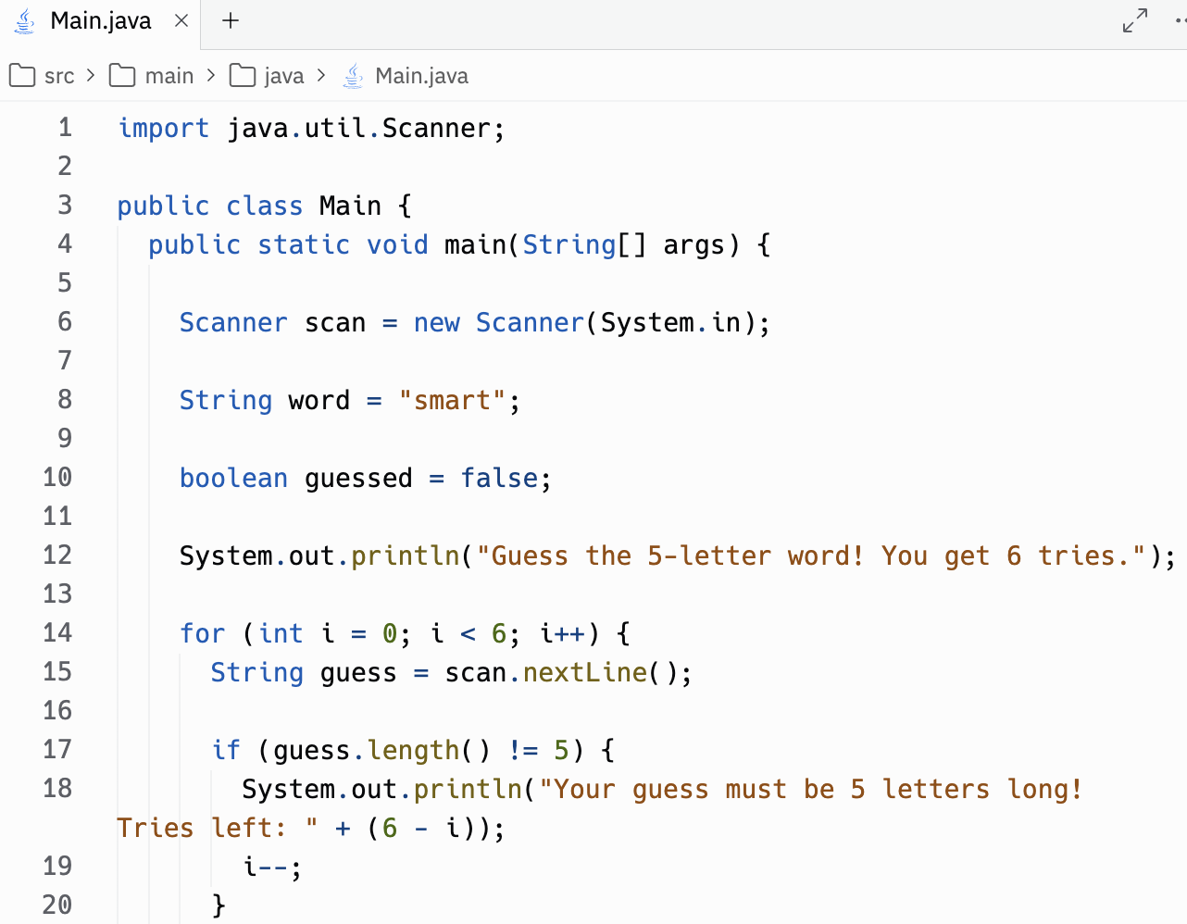
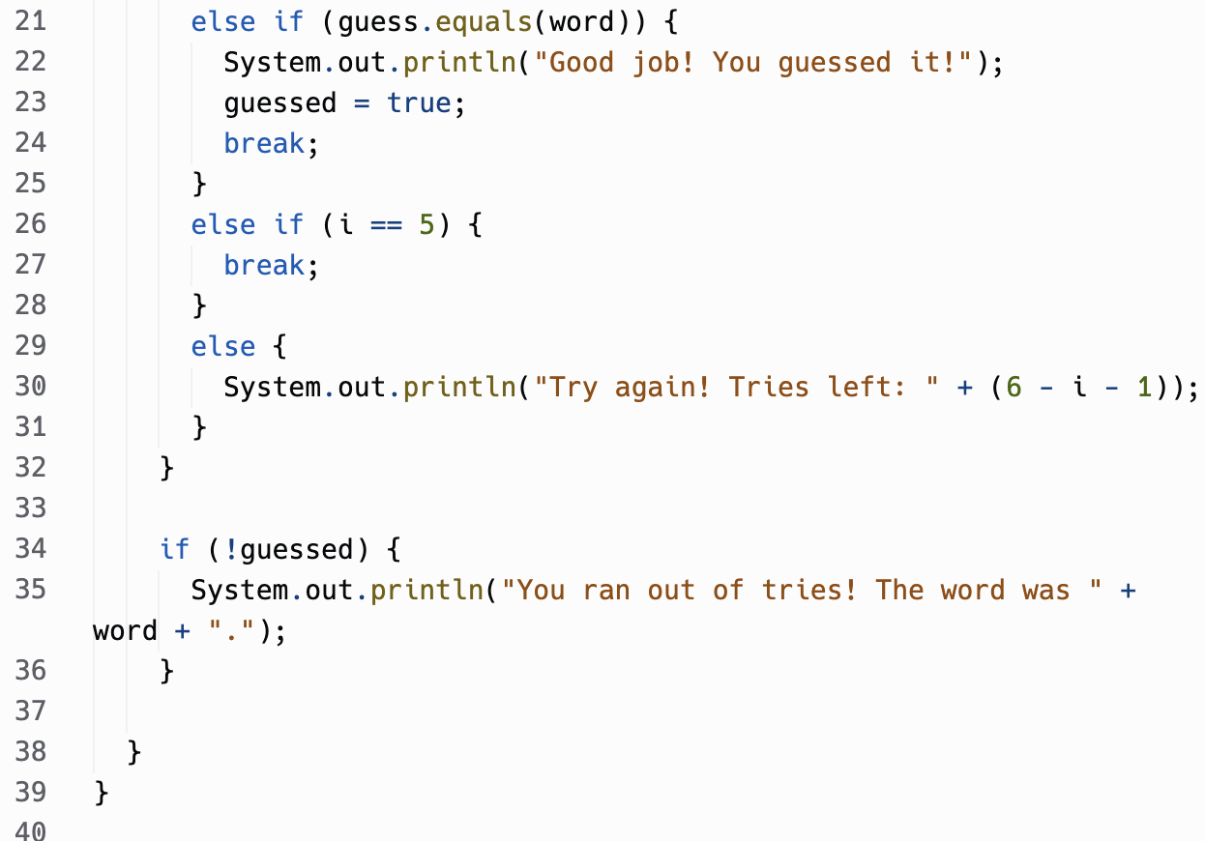
Week 6: Review of Week 1-5 + Challenge
Sample solution code:

Slide 52
Week 6 Project!
We will be programming a game this week! To be able to we first need to learn how to take input:
*Taking input means taking data from the user to use in the program;
Ex. There can be code that tells the program to ask for the user's name, and then there will be a place for the user to type that information in, which the program will then use and print.
*Keep in mind that there are different ways of taking input for different data types but that for this one you will only need to know how to take in String input
To take input in for this project you need these lines of code:
Scanner scanner = new Scanner(System.in)
[variable_name] = scanner.nextLine()

Slide 53
Week 6 Project
This color is for what the program prints
This color is for what you input
This color is for what is added to the code so it can take input
import java.util.Scanner;
class Main {
public static void main(String[] args) {
System.out.println(“What is your name:”);
Scanner scanner = new Scanner(System.in);
String name;
name = scanner.nextLine();
System.out.print("Hello "+ name);
}
}
What appears:
What’s your name:
Sahasra
Hello Sahasra

Slide 54
Week 6 Project
Now that we know how to take in input, we can program our game!
Set the Secret Number: Create a variable to hold the number the user needs to guess.
Prompt the Player: Display “Guess the number:” on the screen. Use another variable to take the player’s input.
Provide Feedback:
Check if the guessed number matches the secret number.
Print helpful hints:
“Go up!” if the guess is too low.
“Go down!” if the guess is too high.
“Correct!” if the guess is right.
Handle Invalid Inputs: If the input isn’t a valid number, print: “Invalid guess. Please enter a number.”
Track Attempts: Keep a count of the guesses the player makes.
End:
Once the player guesses the number print Number of guess: [number of guesses]
Now you’re done!

Slide 55
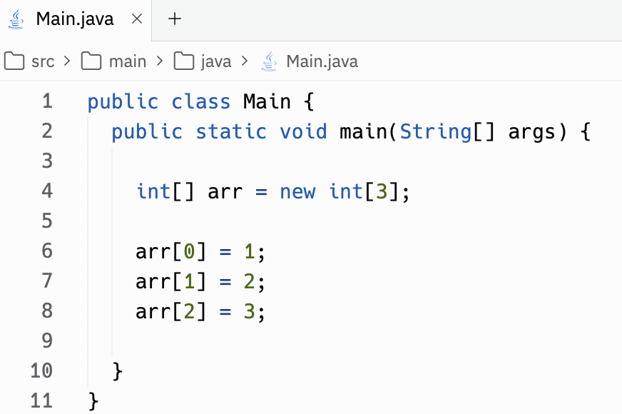
Week 7: Arrays P1 - 1D Array, Traversing an Array, Arrays of Strings
An array is a container object that holds a fixed number of values in a single type. The length of an array cannot be changed after its creation.
To declare an array, it’s the same as declaring a variable except the variable type is followed by square brackets
This number is the amount of elements in the array
Array indexes start from 0, and you can access the elements in the array with the array name and then the index in brackets

Slide 56
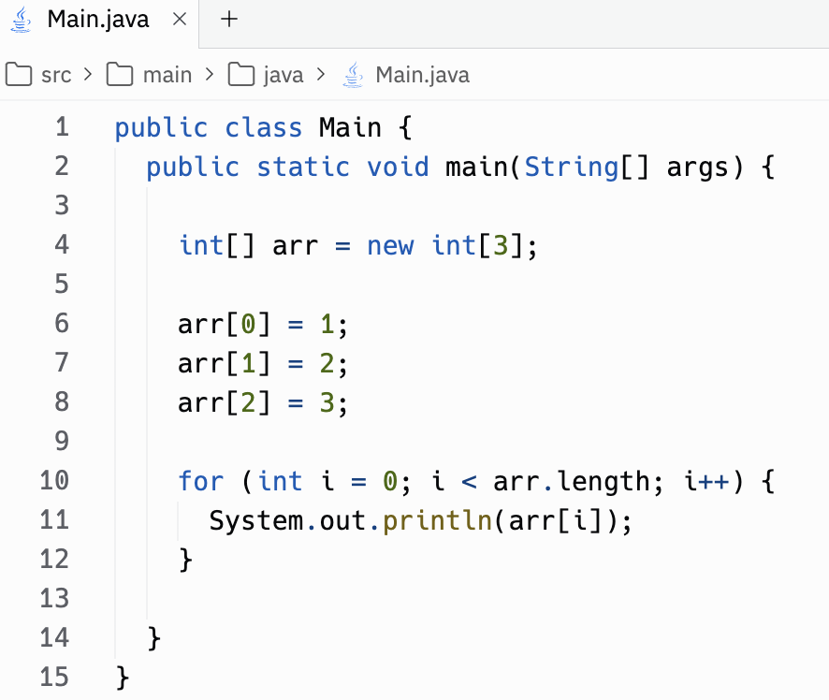
Week 7: Arrays P1 - 1D Array, Traversing an Array, Arrays of Strings
We can use iteration with a for loop to visit each element of an array, which is called traversing the array.
Starts at the index 0, and loops while the index is less than the array length.
Prints out the elements of the array at each index

Slide 57
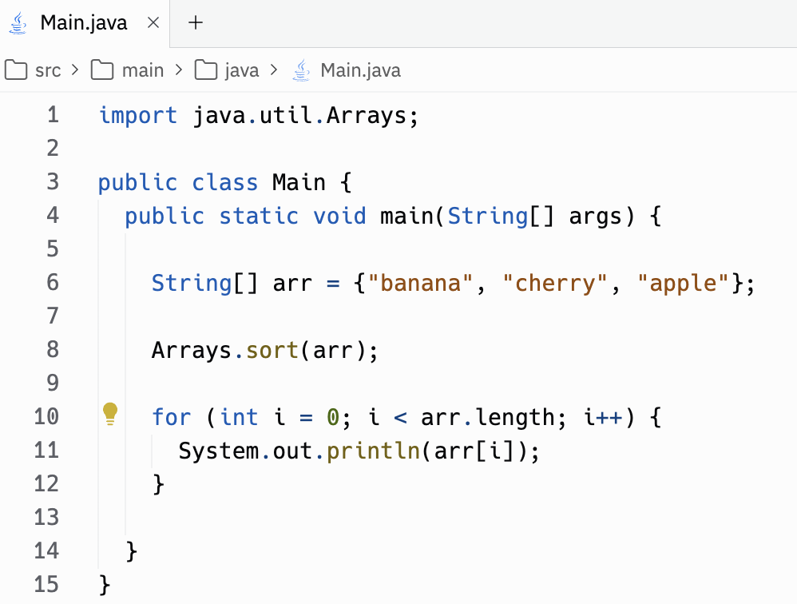
Week 7: Arrays P1 - 1D Array, Traversing an Array, Arrays of Strings
There are many uses for arrays of strings. For example, you could sort all the elements and print them out in order, or search for a specific word in the array
*Another way to create an array is with curly brackets and putting all the elements in it
Sorts the string array and prints out the elements in ascending order:
apple
banana
cherry

Slide 58
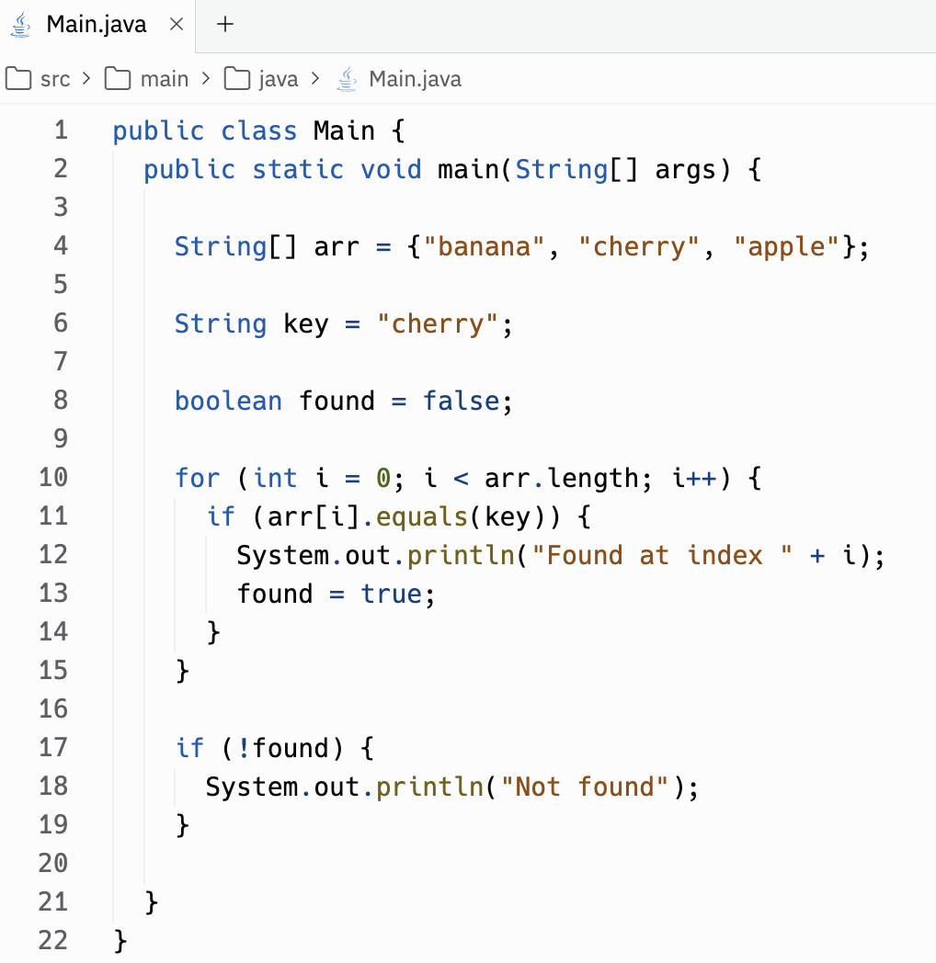
Week 7: Arrays P1 - 1D Array, Traversing an Array, Arrays of Strings
Checks if the word cherry is in the array, and if it is prints the index
Prints out “Found at index 1”

Slide 59
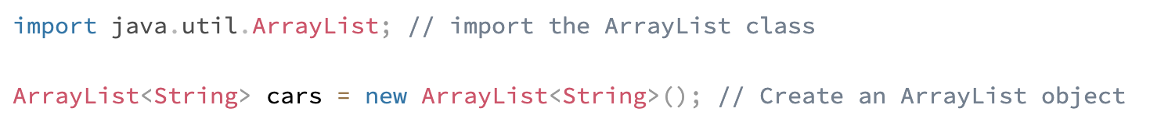
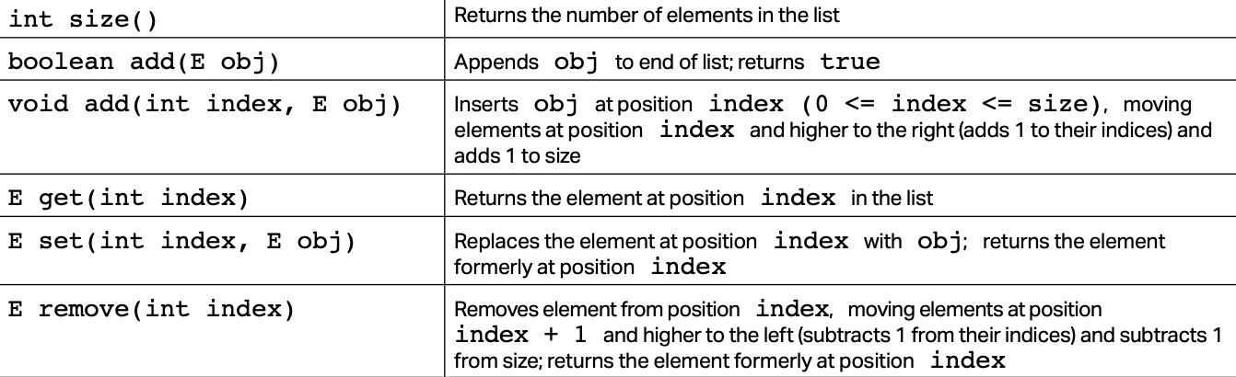
Week 8: Arrays P2 - ArrayList, 2D Array
The ArrayList class is a resizable array and has a slightly different syntax than the array.
How to create an ArrayList object:
The ArrayList class also has a variety of useful methods:

Slide 60
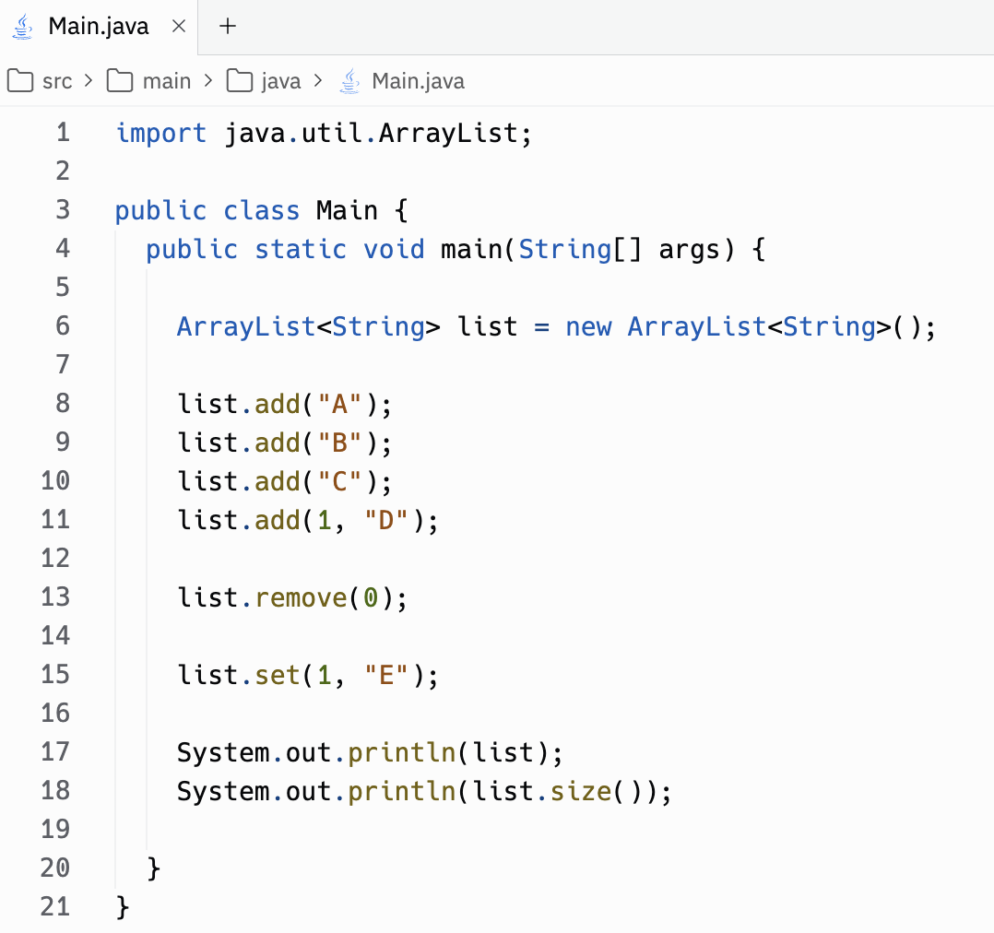
Week 8: Arrays P2 - ArrayList, 2D Array
ArrayList methods are called using dot notation
All elements in an Arraylist are objects
Practice: What will be printed out?
Hint: the size of an ArrayList changes when elements are added/removed

Slide 61
Week 8: Arrays P2 - ArrayList, 2D Array
A 2D array is an array of arrays. It is useful when you want to store data in tabular form, like a table with rows and columns.
To create a 2D array, it’s the same as for a regular array except instead of one set of brackets, you put two set of brackets after the variable type.
Instead of just using one set of curly braces, each array within the array has its own set of curly braces

Slide 62
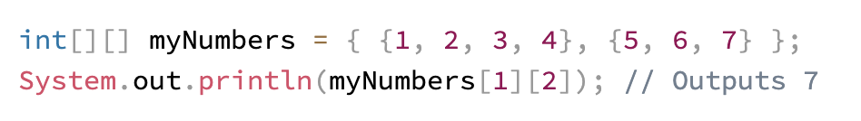
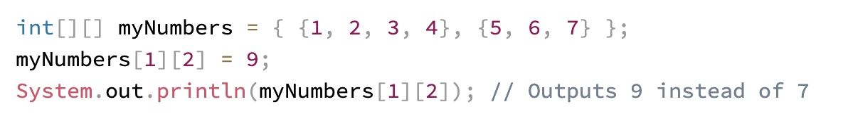
Week 8: Arrays P2 - ArrayList, 2D Array
To access the elements in the 2D array, specify two indexes: one for the array, and one for the element inside that array.
To change the value of an element, it is a similar format to a 1D array

Slide 63
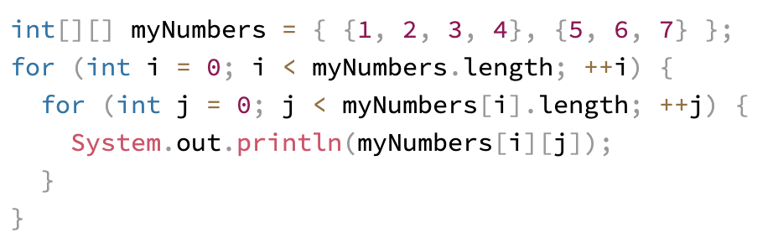
Week 8: Arrays P2 - ArrayList, 2D Array
To loop through a 2D Array, you can use a nested for loop, or a for loop inside another for loop to get the elements of the array (we still have to point to the two indexes)
This will print out all the elements in the 2D array myNumbers
myNumbers.length will get you the number of arrays, myNumbers[i].length will get you the length of each array

Slide 64
Week 9: Objects and Classes
Before continuing to program more complex projects in Java, we need a way to make our code design more organized…
This is where Object Oriented Programming (OOP) comes in!
Object Oriented programming is the process of using organized structures called Objects and Classes to make our code more reusable and easier to understand, which can help us solve problems quicker.
Now let's get into the details of what Objects and Classes really are…

Slide 65
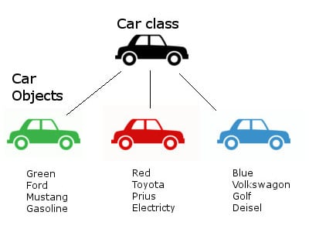
Week 9: Objects and Classes
We use classes to represent things with characteristics in Java
Let's say I wanted to represent a car in Java. I could create a car class with characteristics such as color, manufacturer, model, and fuel source. The CLASS is the blueprint while the OBJECT is the actual car (Ex. Green Ford Mustang)
A class can also perform actions, these are called methods
For example, we could make a honk method that prints out the word honk and call it from our class

Slide 66
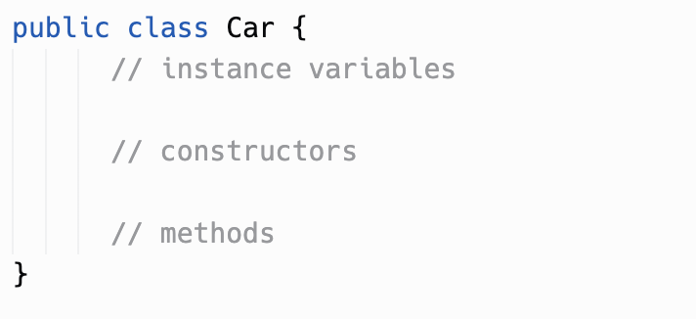
Week 9: Objects and Classes
Each class in Java has three parts (excluding the header). These parts are the instance variables, constructor, and methods.
This is the header of the class, where you can name it.
Make sure your file is named the same as your class

Slide 67
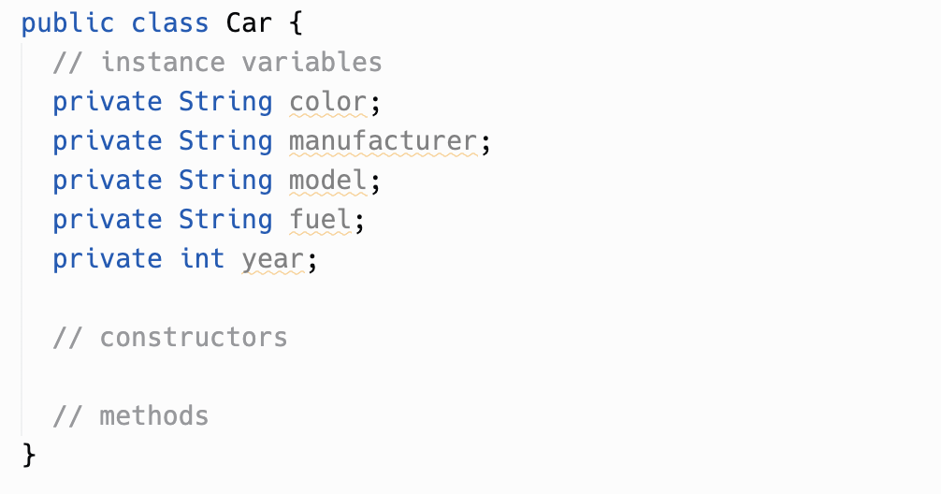
Week 9: Objects and Classes
The instance variables section will list out all the characteristics of your class. Typically, you use the format private Type Name when creating these. List out all the instance variables for the Car class!

Slide 68
Week 9: Objects and Classes
The instance variables section will list out all the characteristics of your class. Typically, you use the format private Type Name when creating these. List out all the instance variables for the Car class!

Slide 69
Week 10: Constructors
Last week we left off on adding our instance variables, lets now figure out how to create a constructor, an essential part of building a java class!

Slide 70
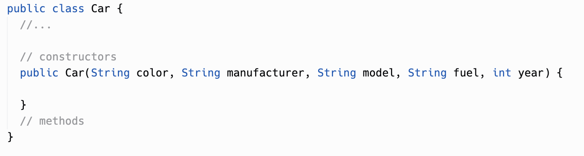
Week 10: Constructors
To build a constructor we type public Name and add all our instance variables into parentheses after it. Make sure to suse public Car and not public class Car for the constructor.

Slide 71
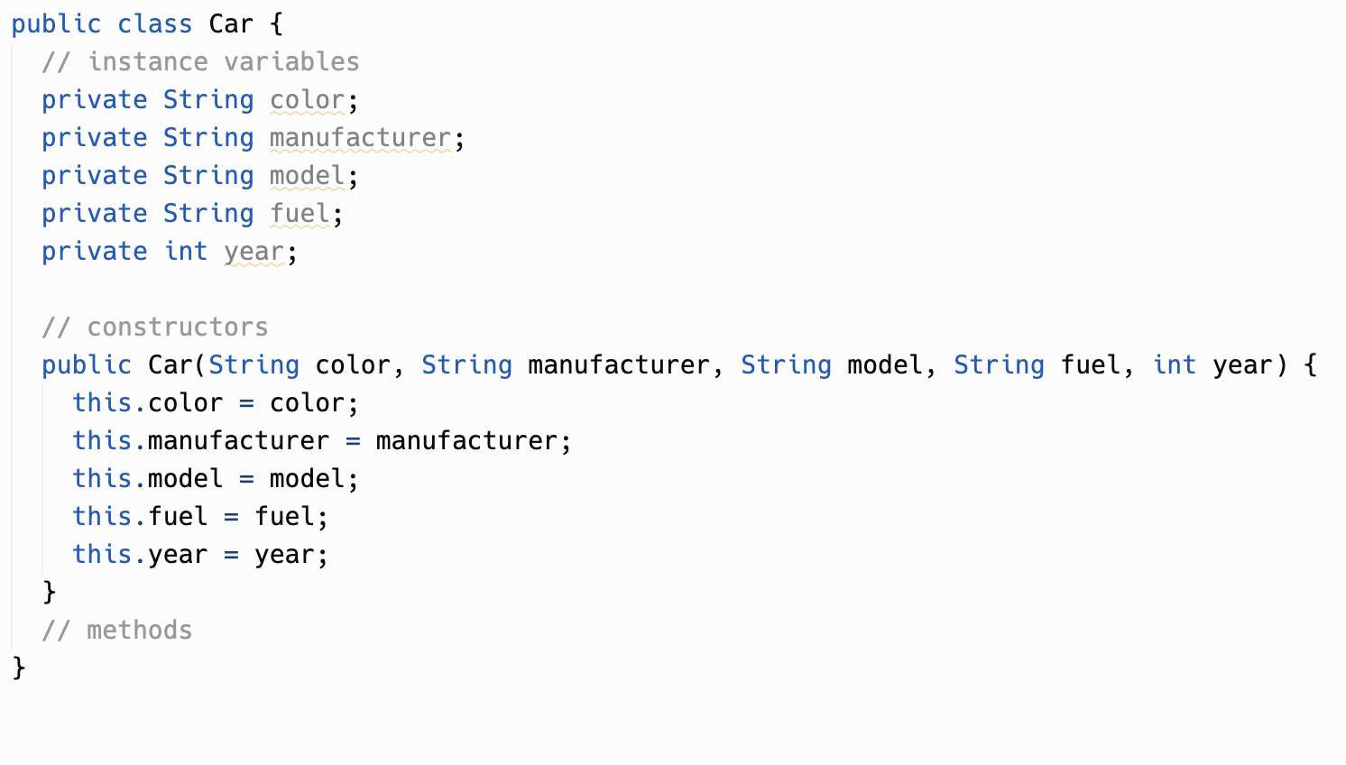

Week 10: Constructors
Now inside the curly brackets, list your instance variables in this fashion. this.variable = variable. Do this for all your variables. Once you have finished that, your code should look like this.
This syntax can be confusing so take a minute to try and understand the code.
Initializing variables. However, they are empty
Allows for us to pass in values for each of these characteristics
Setting the values we pass in as the values of the variables we initialized
*The use of the word “this” will make more sense when we move onto methods

Slide 72

Week 10: Exercise
Create a your own pet class! Think about what characteristics a pet has and create a class for it. Some examples you can use are species and color. Try to think of at least five class attributes for your pet class.

Slide 73

Week 10: Exercise Solution
This is just one example of a pet class. Your class can have different attributes, so don’t be afraid if it looks a bit different! Just make sure you got the essential syntax right and that your types match your variables.

Slide 74


Week 10: Objects
Now lets learn how to make objects! Creating a new object is a lot like creating a new variable. Let’s use the pet class we just made. Back in your main file, type this.
Notice how the values in the parentheses are the same characteristics I defined in my class. By passing these values im telling the class that my pet lucy is a species: dog, color: yellow, name: Lucy, age: 6, and hasFourLegs: true

Slide 75

Week 10: Objects Mini Exercise
Take this code and modify it to fit either your pet or a made up one. Make sure the values you pass in are the same types as the ones you defined in your own class AND are in the same order
Notice how the values i pass in and the ones i defined in my constructor are aligned in the same order and are the same type

Slide 76

Week 11: Methods
Now that we have a class and an object, we want to achieve something with these structures. Lets trying making our pet do a trick! We can do this using methods. Go back to your Pet.java file and type this. This is the function declaration.
public - this method can be accessed by other classes and files
void - the function doesn’t return anything. We’ll get into returns later
sit - the name of the function

Slide 77

Week 11: Methods
To make the function run code, we type our code inside the braces. I’m going to make my function print “your pet sat” but you can modify that how you like

Slide 78


Week 11: Methods
*In the sit function in Pet.java
Instead of printing your pet sat, I want the message to be specific to the pet. For example, for the Lucy object, I want the console to print Lucy sat.
I can do this using the this keyword. “This” represents the object itself. this.name would give me the name of the specific Pet, this.age would give me the age of the object. We can only use this in the class file though.
Let’s try it out!
And just like that, the message is specific to my pet!
*This also means that instead of modifying the method code whenever we want a different name for the message, we instead just alter the value we pass in the object declaration, “Pet lucy = new Pet("dog", "yellow", "Lucy", 6, true);”

Slide 79



Week 11: Methods
In Pet.java create a trick method that takes in an action parameter. The parameter is defined in the parentheses after the method name
Now to further customize this example, I want the user to be able to pass in what action their pet is doing! We can do this by giving our method parameters. Parameters are customizable values we can pass into methods to change their behavior
Let’s try it out in the Pet class.
Now call it in the main file, and input your value

Slide 80


Week 11: Methods
*In Pet.java after the sit function
Return type changed
Sometimes, instead of printing something out, we want to return a value. For example, I may want to return my pet’s age in dog years to store in a variable. We do this using the return keyword and by changing the function declaration.
I’m going to make a new function called returnDogYears which will give me an integer value for my pet’s age in dog years. (feel free to modify this for your specific pet…cat years, fish years, bird years)
Return Keyword
We can then use this function in the main code. If you try printing out this variable you will receive 42.

Slide 81

Week 12: OOP Design and Inheritance
A common design pattern in OOP Java programming is the use of “getter” and “setter” functions.
A getter function is a public method that returns the value of an attribute
A setter function is a private method that sets the value of an attribute
Getter functions take no parameters but share the return type of the attribute their returning
Setter functions take parameters but have a void return type

Slide 82

Week 12: OOP Design and Inheritance
*Subclasses are called child classes and the classes they inherit from are called parent classes
Sometimes we like to create subclasses of other classes. Notice how until now we’ve had a broader Pet class rather than specific pets like a Dog, Fish, or Bird class. Something we can do in Java is pass down all characteristics of the Pet class into smaller subclasses, like a Dog, Fish, or Bird class. This is known as inheritance
This portrays the OOP structure we’ve learned about so far.

Slide 83

Week 12: OOP Design and Inheritance
We inherit from parent classes using the extends keyword. The structure of a child class is nearly identical to that of any regular class. Create a new Dog.java file and begin coding
Keep a track of the syntax.
public class -> class
We add any new characteristics as new instance variables.
We pass in old arguments to the constructor as well as new ones
We use a super keyword to assign values of the old attributes, and create separate lines for new ones
*don’t worry about the spacing in this example, the constructor is split into different lines to make it more readable

Slide 84

Week 12: Project
Goal: Create a child class representing a specific animal for your parent Pet class
Make sure it has two new attributes in it and getter and setter functions for those attributes
In the child class create a convertToYears function that returns an integer of the pet’s age in its respective years. Ex. dog’s age=normal age*7
Create a feedPet function which takes in a food parameter and prints out “PET ate FOOD!” where PET is the name attribute and FOOD is the parameter. Call it in the main file. Ex. Lucy ate chicken!

Slide 85

Week 12-End: Semester Project
Last week, you had a taste of what it looks like to combine everything we’ve learned into a single program.
From this point on (depending on how much time is left before the semester), you will now be focused on creating your own project.
It doesn’t have to be as complex as what we did (or it can be more!), but really try practicing what you know, and have fun while doing it!
If you need a review/help , your instructor can go back to previous weeks if you ask! GOOD LUCK!!!

